Slide 1

By <Student Name>
Business Analyst Career Program - Capstone Project

Slide 2

Agenda
Data Exploration
Statistical Analysis using Excel
Graphical Analysis using Excel
Insert the given data into the SQL server
Import the Data from the SQL Database into PowerBI
Interactive Dashboard by using visualization tools
Conclusion and Inferences
Endnotes

Slide 3
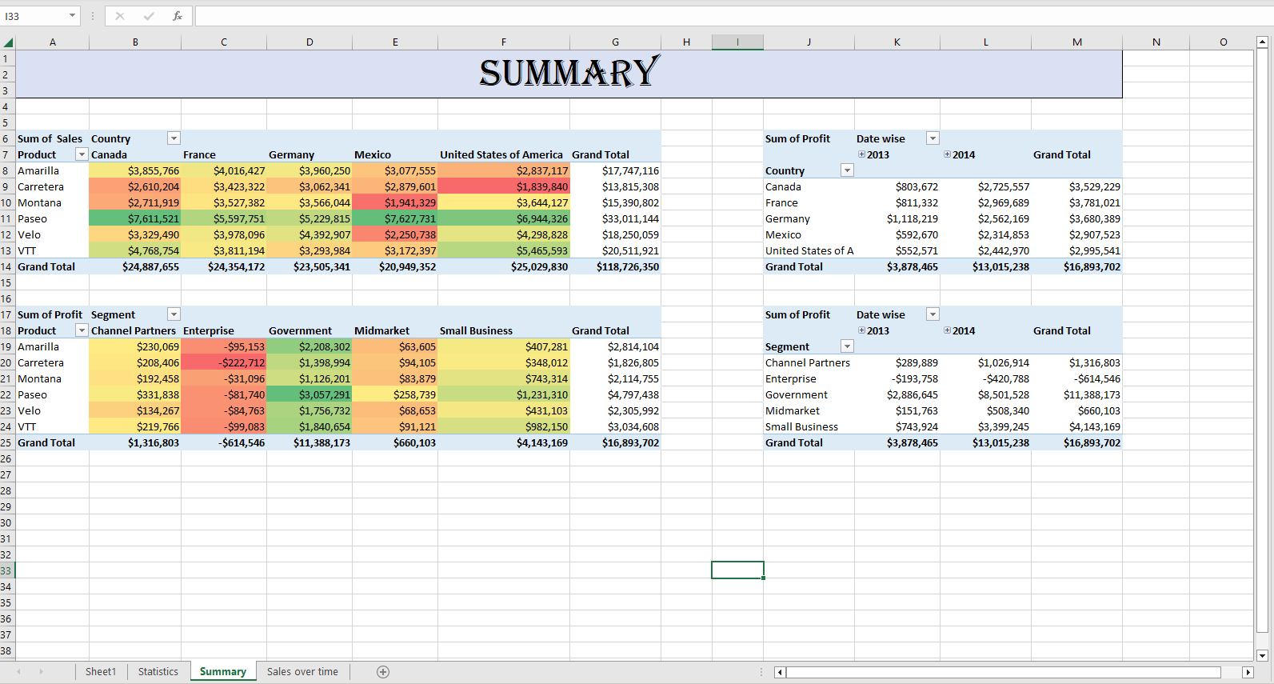
Data Exploration
Created a pivot table of sales by country , profit by segment , profit by product , profit by country to brief summarise data

Slide 4
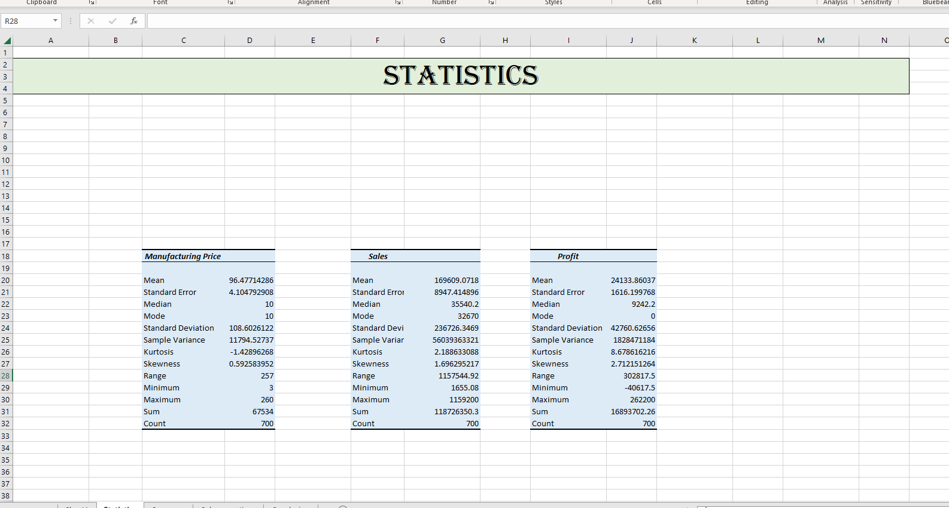
Statistical Analysis using Excel
Using data analysis tool descriptive analysis is performed over data and found out mean, median, mode, variance and other measure of numerical columns to identify statistics of data

Slide 5
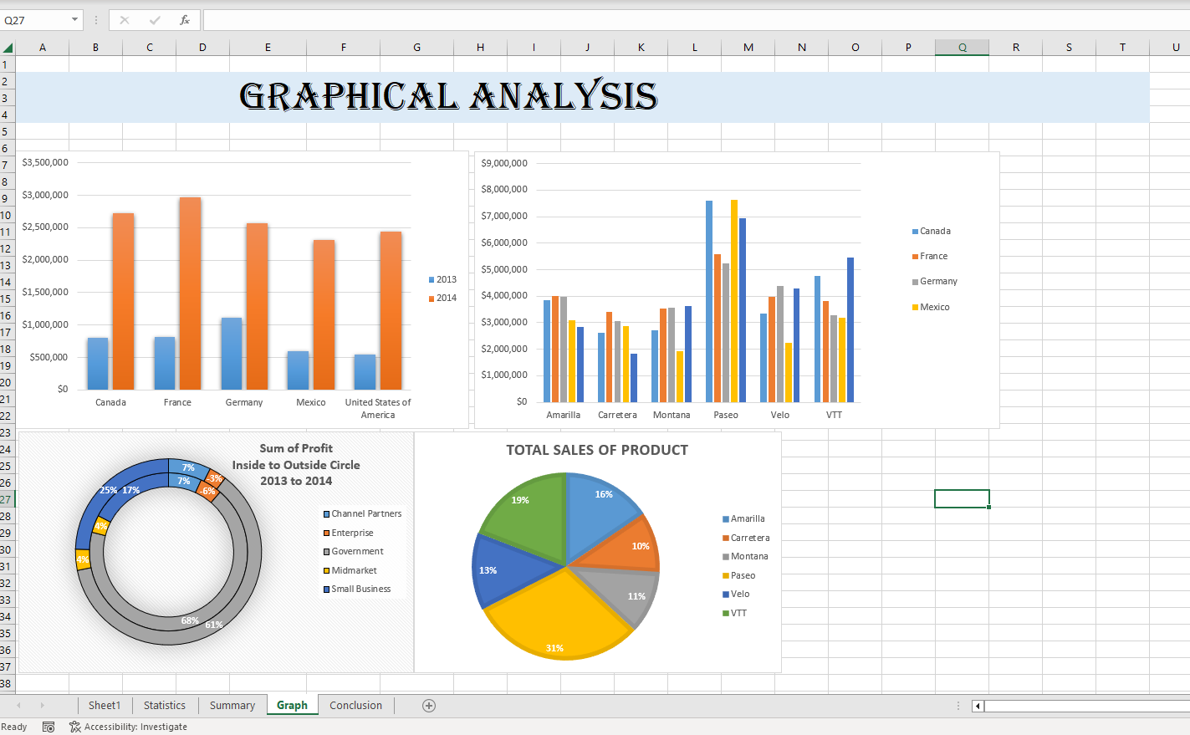
Graphical Analysis using Excel
Graphical charts created using data table and different columns and identify sales variation with country, segment product and Time

Slide 6
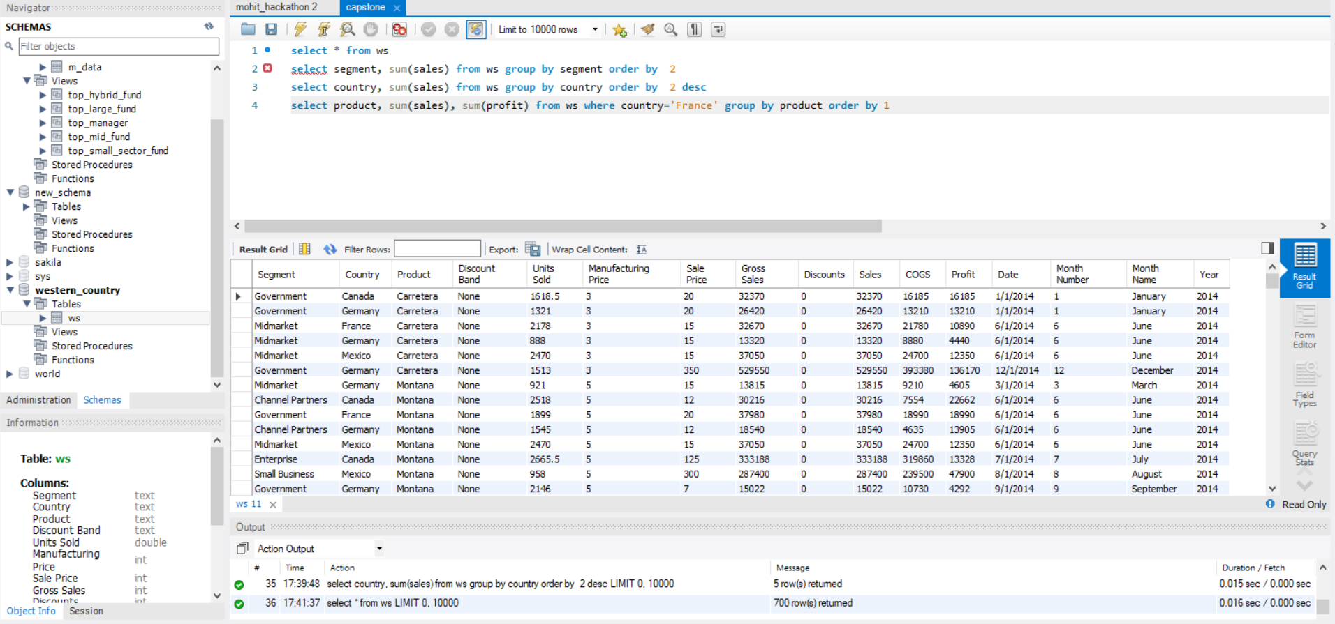
Insert the given data into the SQL server
New schema create named wester_country and using table data import wizard
Table created and some basics SQL queries performed using group by , order by and where clauses

Slide 7
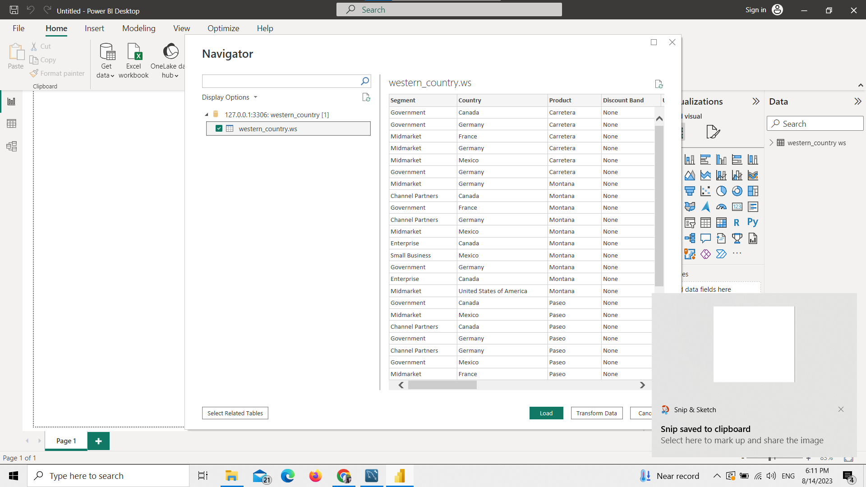
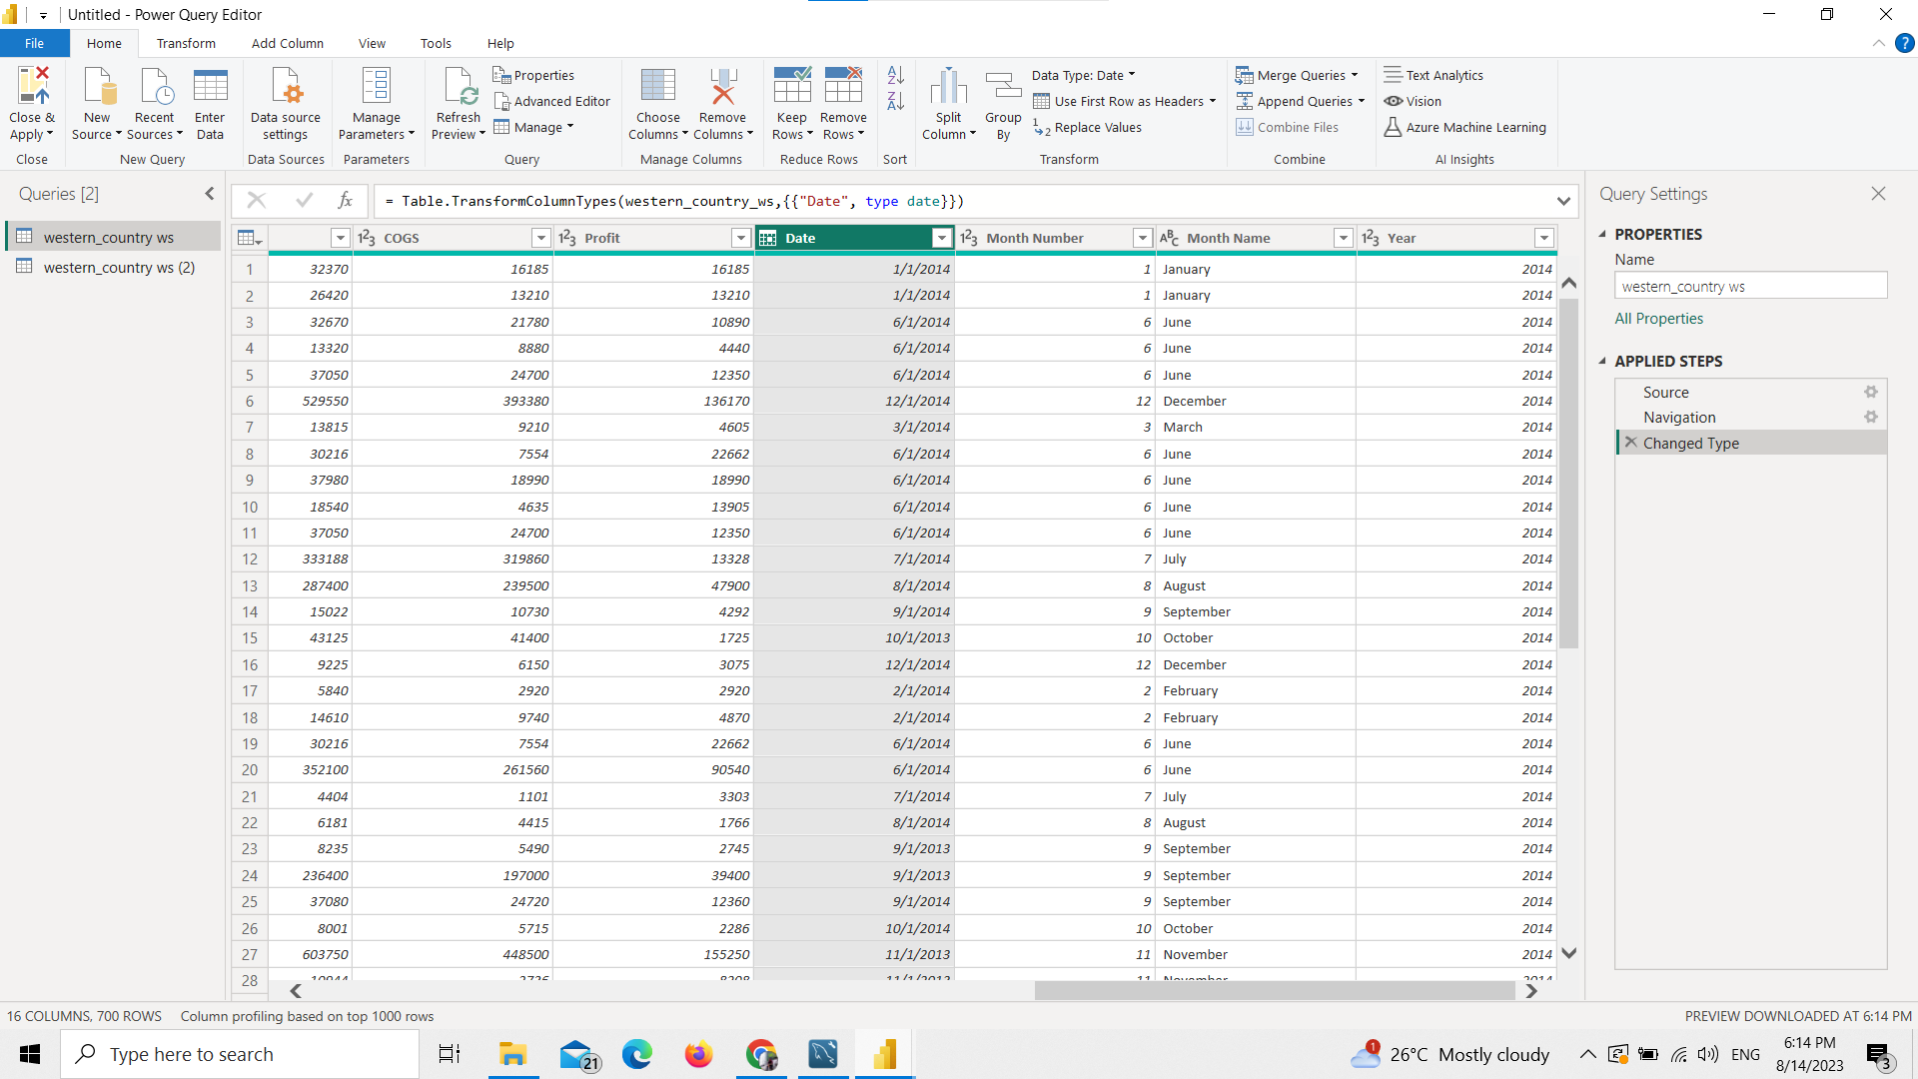
Import the Data from the SQL Database into PowerBI
Using Get data tab and selecting mysql database , connected to mysql server, imported table, then using power query editor column datatype and column names corrected

Slide 8
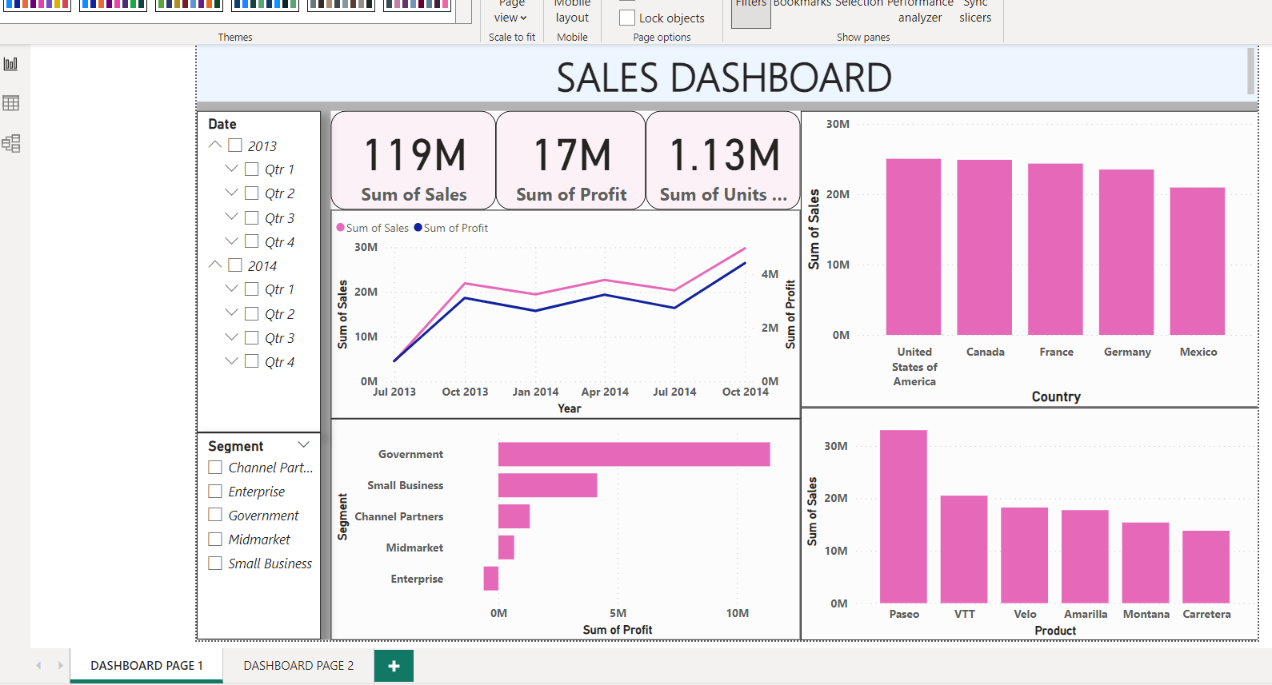
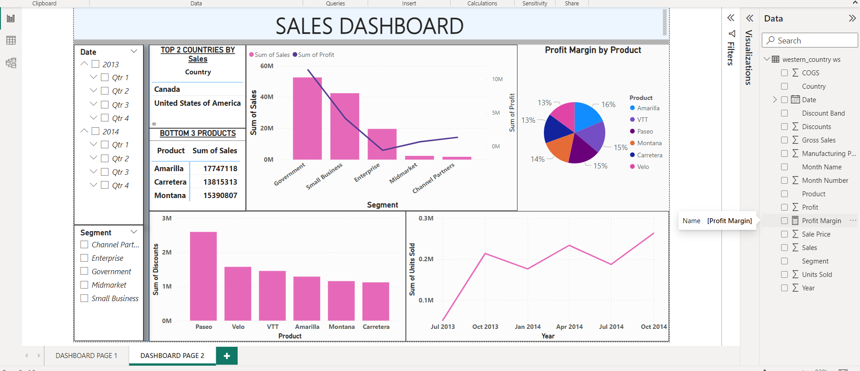
Interactive Dashboard by using visualization tools
Dashboard created showing all graphs as requested in question and also created new measure name profit margin shows profit percentage over sales

Slide 9
Conclusion and Inferences
The most popular and successful product is Paseo
Nation with the Best performance are USA, Canada followed by France, Germany and Mexico
The Enterprises Segment is losing money.
The government Sector is the most lucrative industry.
With sales rising in the fourth quarter each year, this is the time to focus on marketing.

Slide 10
Endnotes
Reference Links:-
Insert related links for Excel file, PowerBI file

